Slide 1

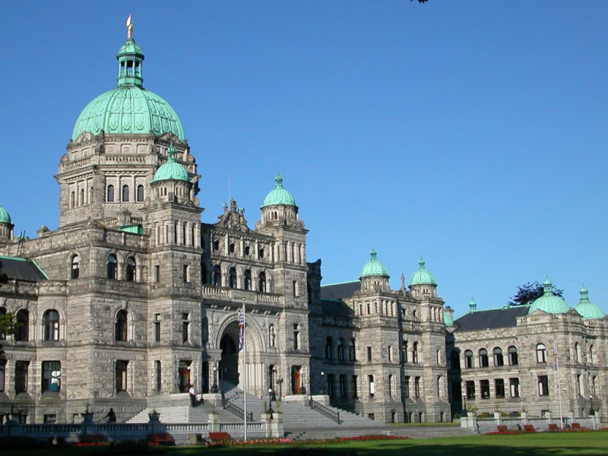
Budget Consultations
in British Columbia
Kate Ryan-Lloyd
Deputy Clerk and Clerk of Committees

Slide 2
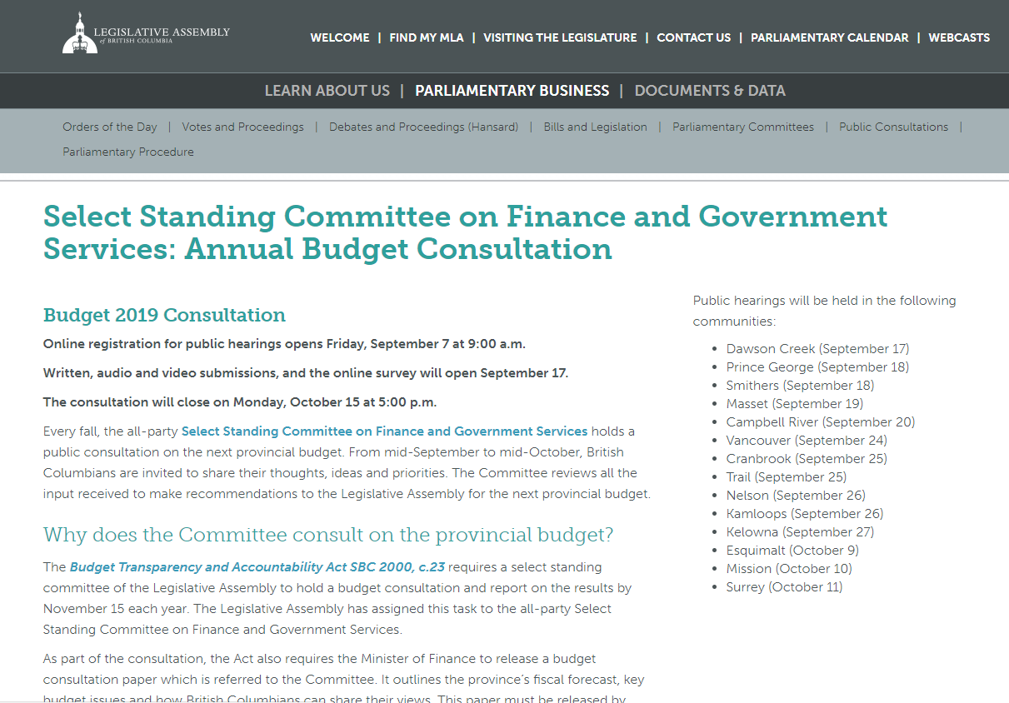
BC Budget Consultation Process
Established by Statute in 2000
Budget Transparency and Accountability Act
Budget Consultation Paper
Consultation begins by September 15
Committee Report for the Legislative Assembly by November 15

Slide 3
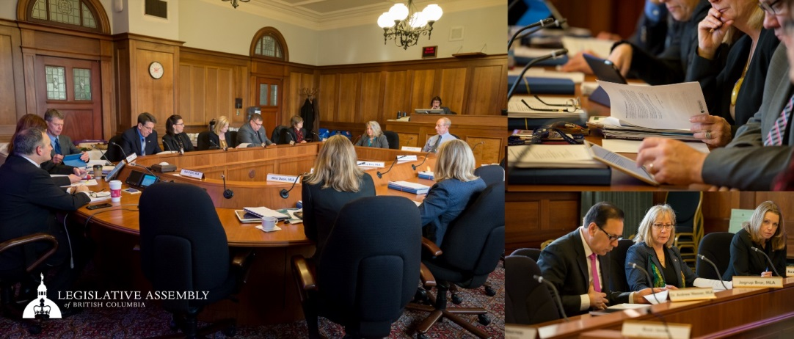
Overview of the BC Budget Consultation Process
Regional public hearings
Written submissions
Online survey responses
Video and audio submissions
Skype and Teleconference Options

Slide 4
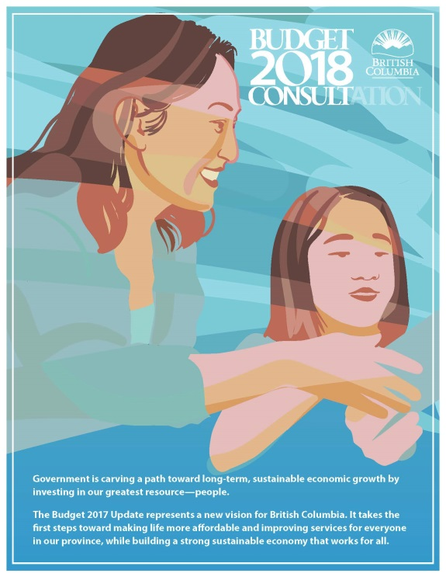
Roles in Budget Development
Executive Branch
Ministry of Finance
Prepares Budget Consultation Paper
Following report release, considers recommendations
Prepares and presents annual budget
Implements, manages and reports on budget

Slide 5
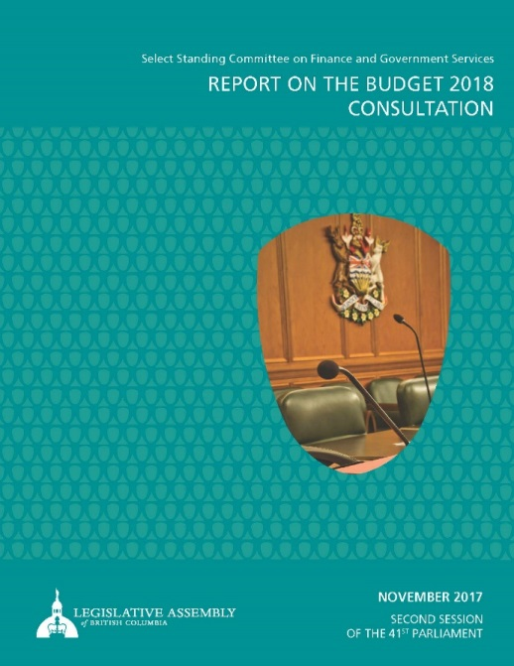
Roles in Budget Development
Legislative Branch
Select Standing Committee on Finance and Government Services
Budget Consultations
Membership comprised of all recognized parties
Deliberates on findings
Provides balanced recommendations
Reports to Legislative Assembly

Slide 6
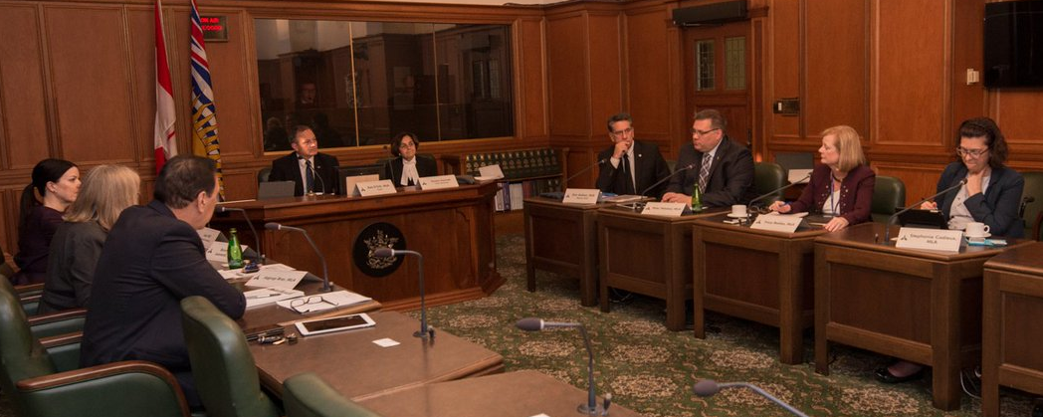
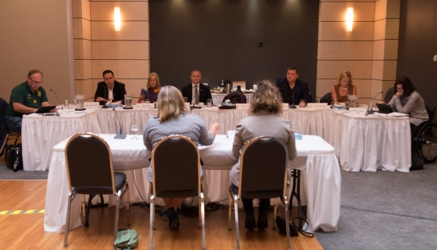
Citizen Participation and Engagement
Outreach in the past
New Communications and outreach strategies
Online engagement and advertising
Targeted engagement
  Individuals and organizations
  First time participants
  Indigenous Outreach

Slide 7
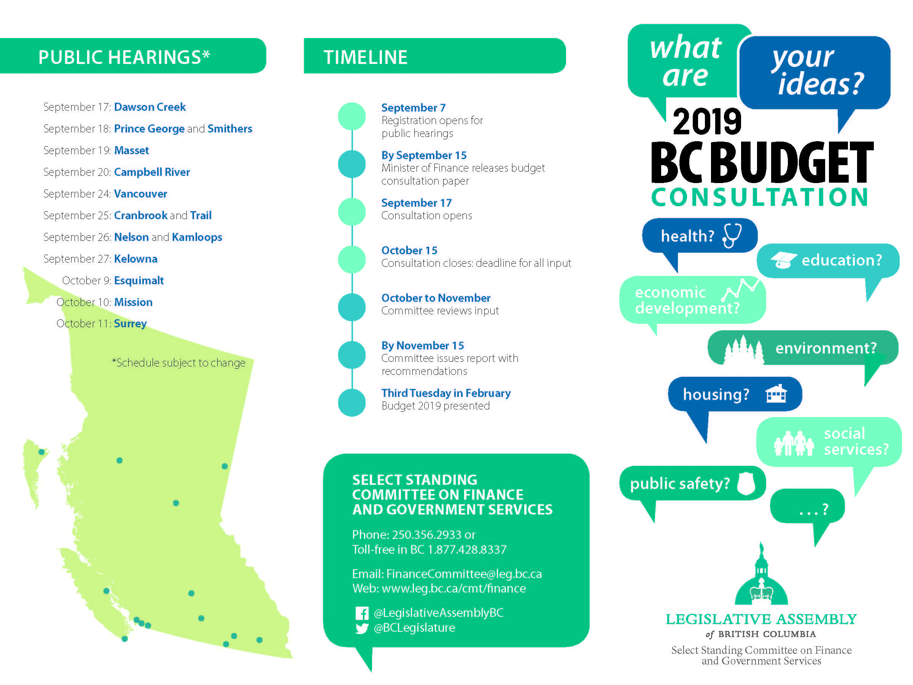
Brochure
on the Consultation

Slide 8

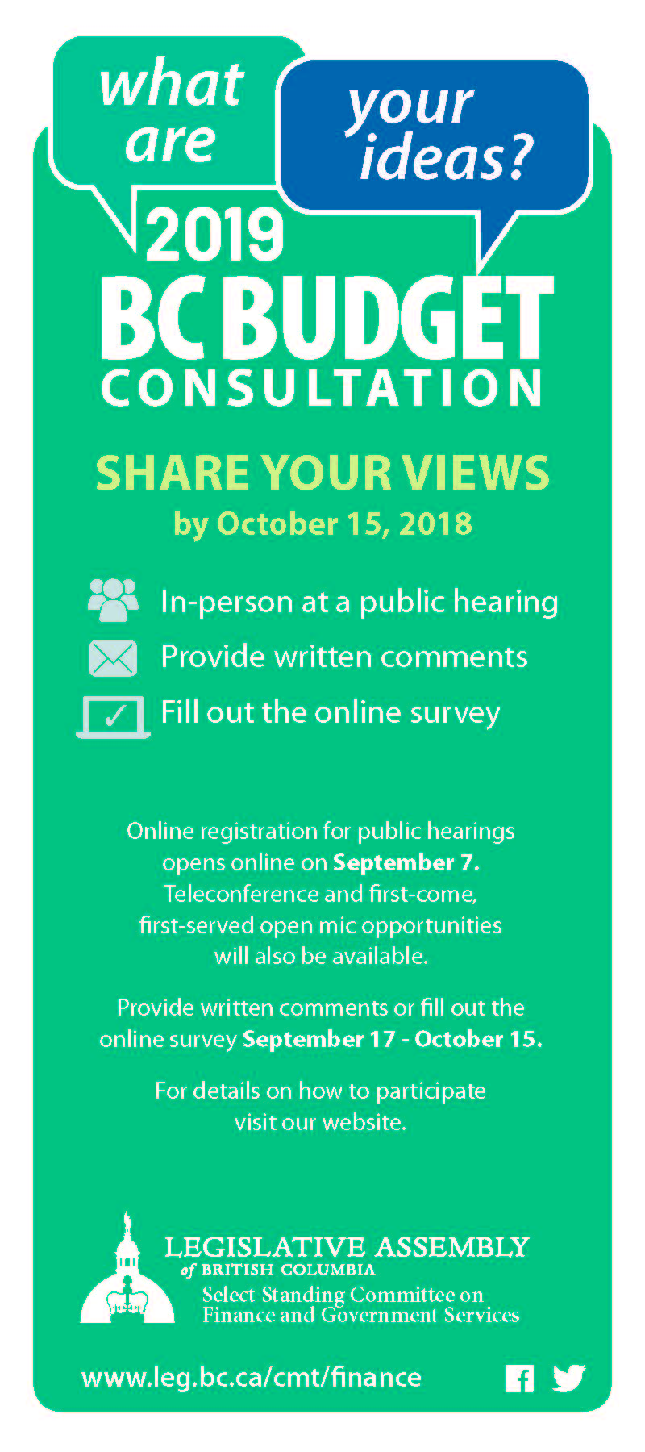
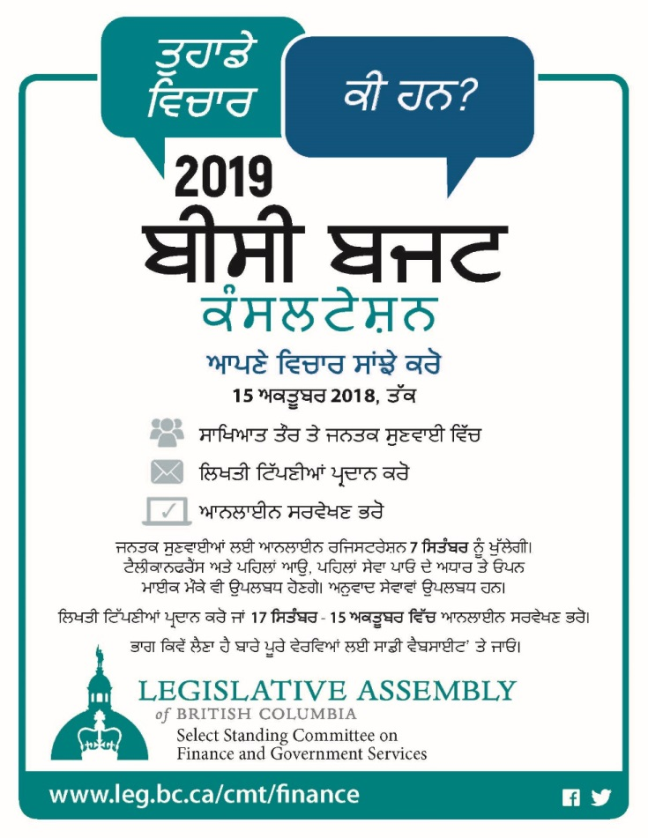
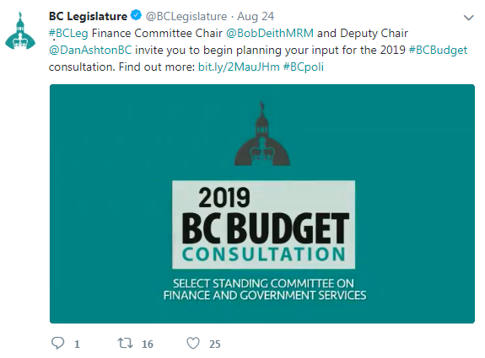
Rack Card
Online Ad
Social Media
Consultation Poster

Slide 9
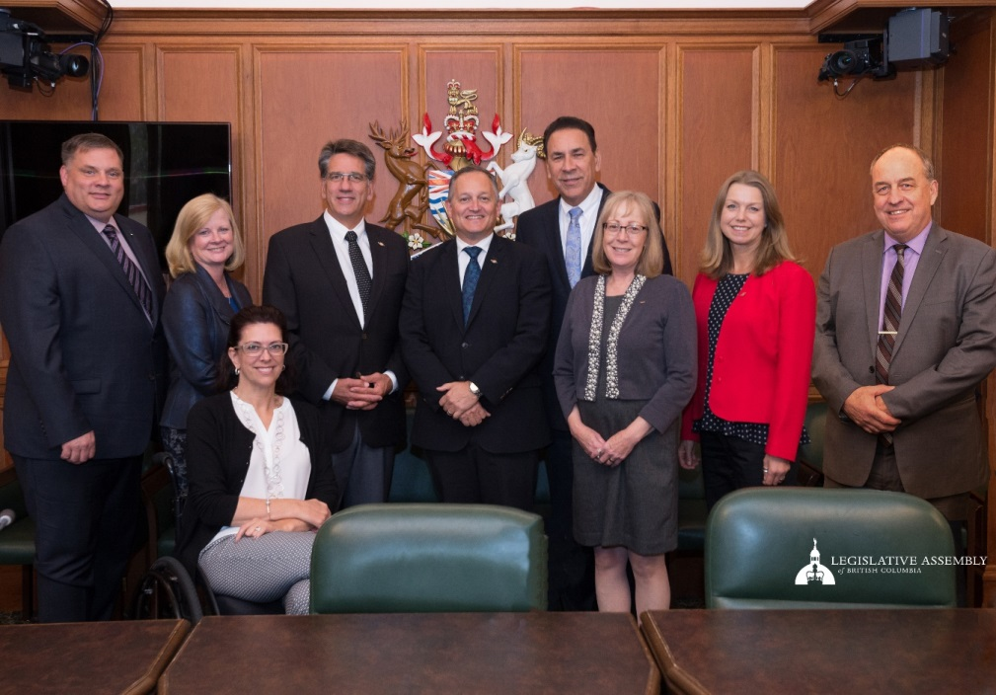
Next Steps
Explore participatory budgeting
Tracking the impact and implementation of Committee recommendations
Renewed online communication and outreach to new participants

Slide 10
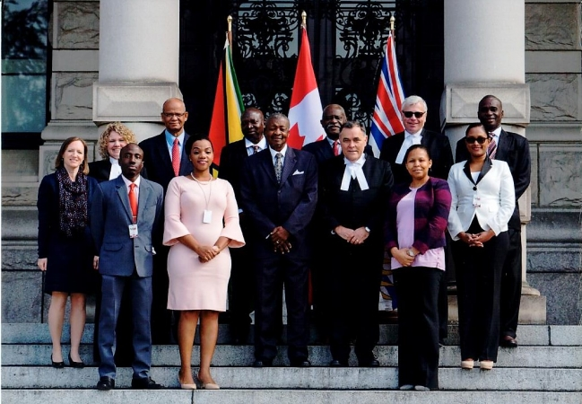




Thank you
Kate Ryan-Lloyd
Deputy Clerk and Clerk of Committees
Kate.Ryan-Lloyd@leg.bc.ca
Room 224, Parliament Buildings
p. 250-356-2933
www.leg.bc.ca
@BCLegislature
LegislativeAssemblyBC

